Slide 1
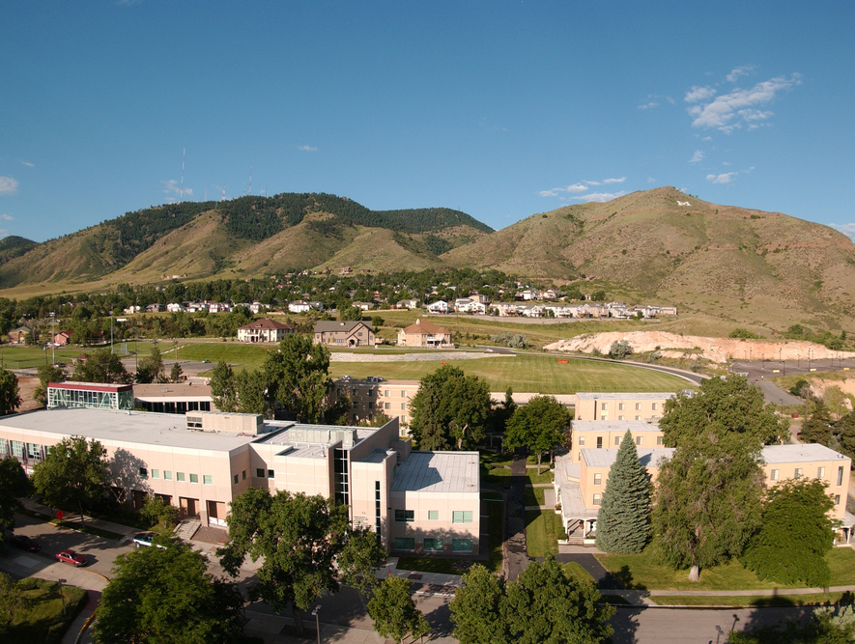
Colorado School of Mines
Computer Vision
Professor William Hoff
Dept of Computer Science
http://inside.mines.edu/~whoff/

Slide 2
Color

Slide 3
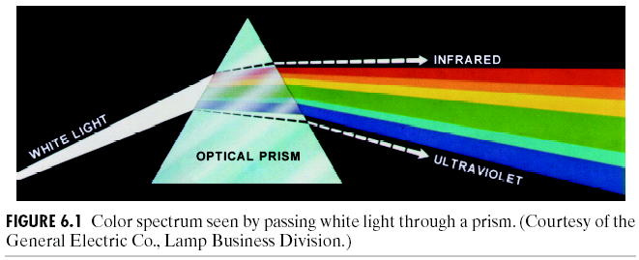
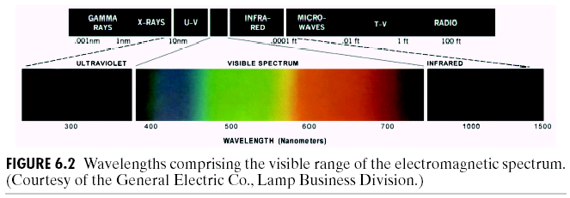
Color
Image values are a vector instead of a scalar
Example: I(x,y) = (red, green, blue)
Most gray scale methods are directly applicable to color images
Human vision can perceive about 400-700 nm

Slide 4
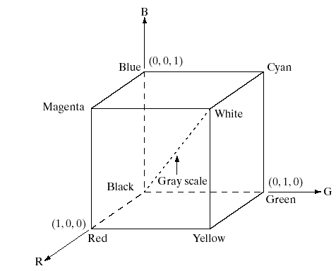
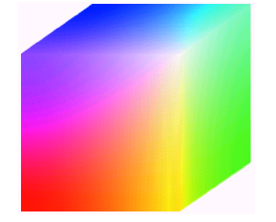
RGB Color Model

Slide 5
Storage of Color Images
Separate values for R,G,B
Example: f(x,y,c), where c=1,2,3
Using a colormap
Image f(x,y) stores indices into a lookup table (colormap)
Colormap specifies RGB for each index

Slide 6
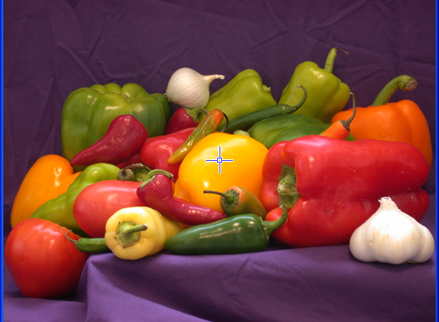
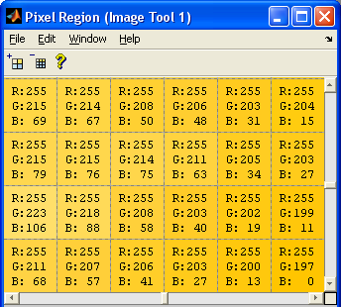
RGB Storage
Separate values for R,G,B
Example: f(x,y,c), where c=1,2,3

Slide 7
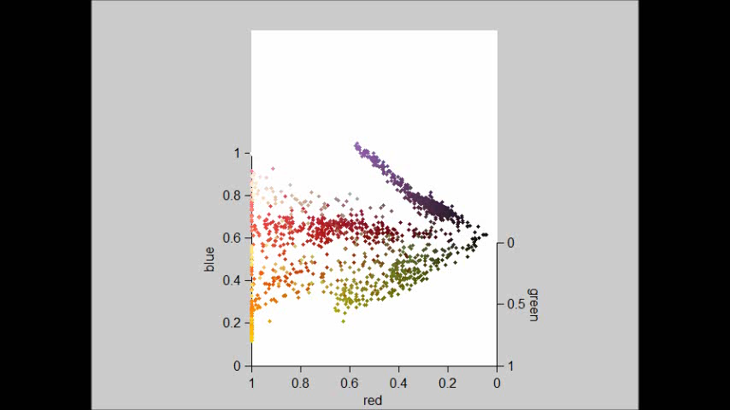
Visualizing RGB Image Values

Slide 8
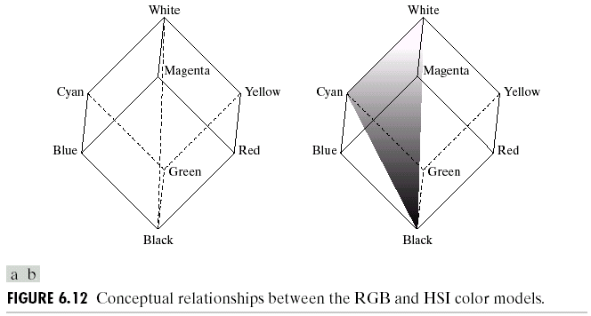
HSI Color Model
Often it is better to analyze color images using the hue, saturation, intensity (or value) color model
Intensity often changes depending on the lighting, but hue and saturation are independent of intensity

Slide 9
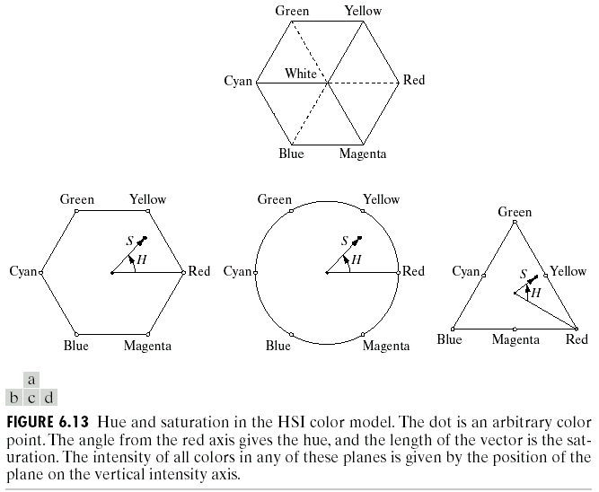

Slide 10
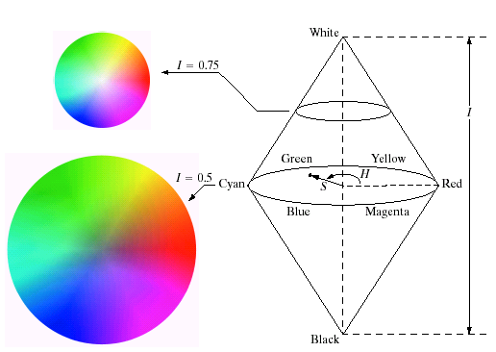

Slide 11
Conversion from RGB to HSI
R,G,B are 0..1

Slide 12
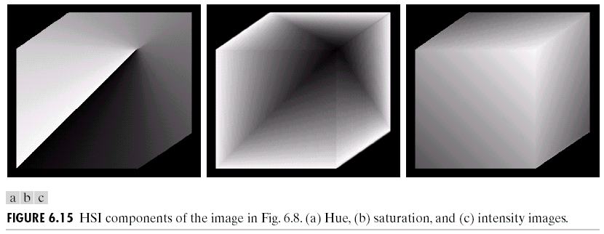

Slide 13
Segmentation Example
Say we want to detect pixels of a certain color
We convert the RGB (or BGR) image to HSV
Threshold each of the HSV images
Then, combine the three thresholded images

Slide 14
Example
hsv_img = cv2.cvtColor(
bgr_img, cv2.COLOR_BGR2HSV)
Hue
Saturation
BGR image
Value

Slide 15
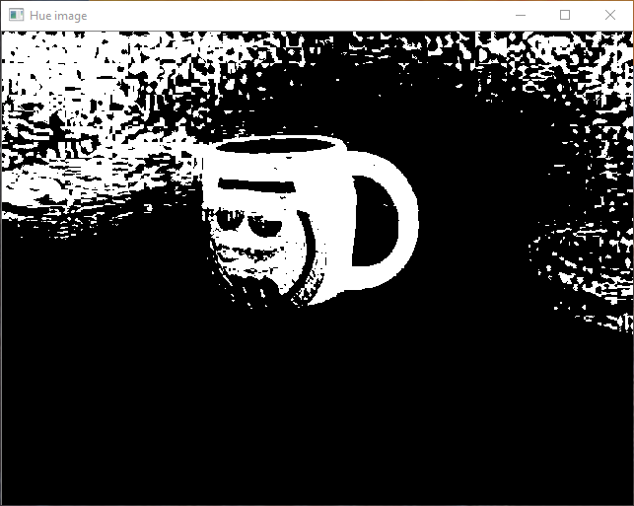
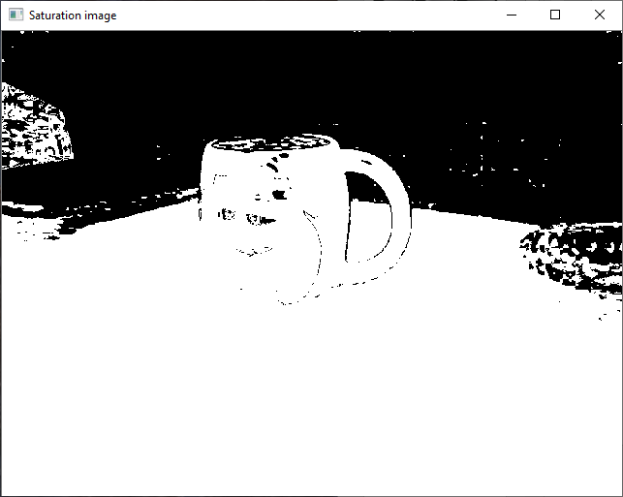
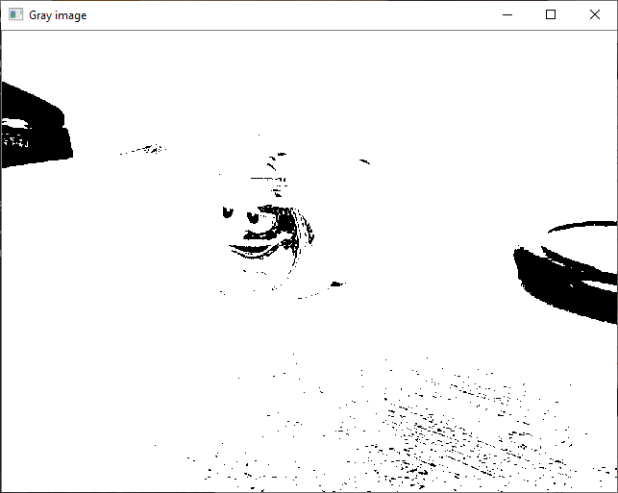
import cv2 import numpy as np low_thresholds = [50, 50, 50] high_thresholds = [250, 250, 250] def main(): bgr_img = cv2.imread("cup.jpg") image_height = bgr_img.shape[0] image_width = bgr_img.shape[1] cv2.imshow("Input image", bgr_img) # Convert BGR to HSV. hsv_img = cv2.cvtColor(bgr_img, cv2.COLOR_BGR2HSV) cv2.imshow("HSV image", hsv_img) # Split into the different bands. planes = cv2.split(hsv_img) windowNames = ["Hue image", "Saturation image", "Gray image"] for i in range(3): cv2.namedWindow(windowNames[i]) # Create output thresholded image. thresh_img = np.full((image_height, image_width), 255, dtype=np.uint8) for i in range(3): low_val = low_thresholds[i] high_val = high_thresholds[i] _,low_img = cv2.threshold(planes[i], low_val, 255, cv2.THRESH_BINARY) _,high_img = cv2.threshold(planes[i], high_val, 255, cv2.THRESH_BINARY_INV) thresh_band_img = cv2.bitwise_and(low_img, high_img) cv2.imshow(windowNames[i], thresh_band_img) # AND with output thresholded image. thresh_img = cv2.bitwise_and(thresh_img, thresh_band_img) cv2.imshow("Output thresholded image", thresh_img) cv2.waitKey(0) if __name__ == "__main__": main()

Slide 16
Trackbars
Let’s use trackbars, to make it easier to adjust the thresholds
cv2.createTrackbar(trackbar_name, title_window , 0, slider_max, on_trackbar)
Parameters
The Trackbar has a label “trackbar_name”
The Trackbar is located in the window named “title_window”
The Trackbar values will be in the range from 0 to “slider_max” (the minimum limit is always zero)
Whenever the user moves the Trackbar, the callback function “on_trackbar” is called
You can get the Trackbar position using
r = cv2.getTrackbarPos(trackbar_name, title_window)

Slide 17
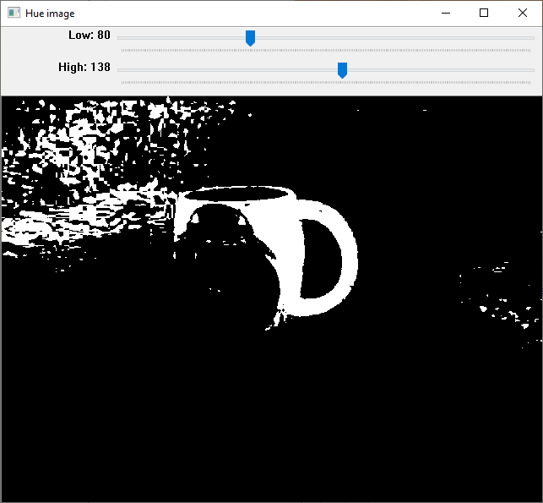
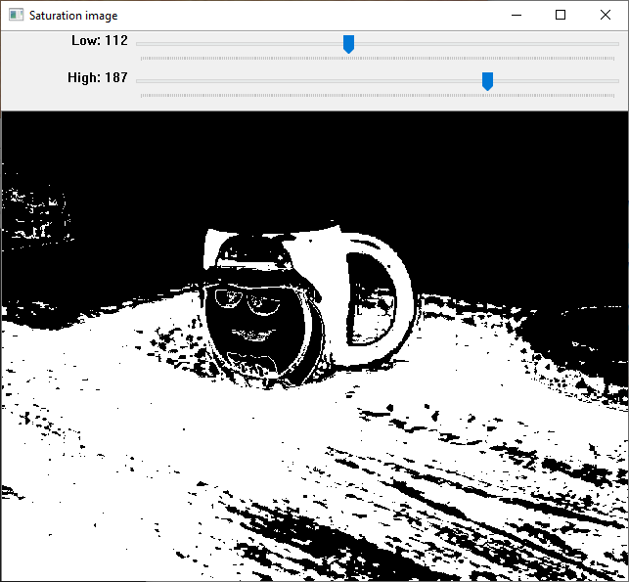
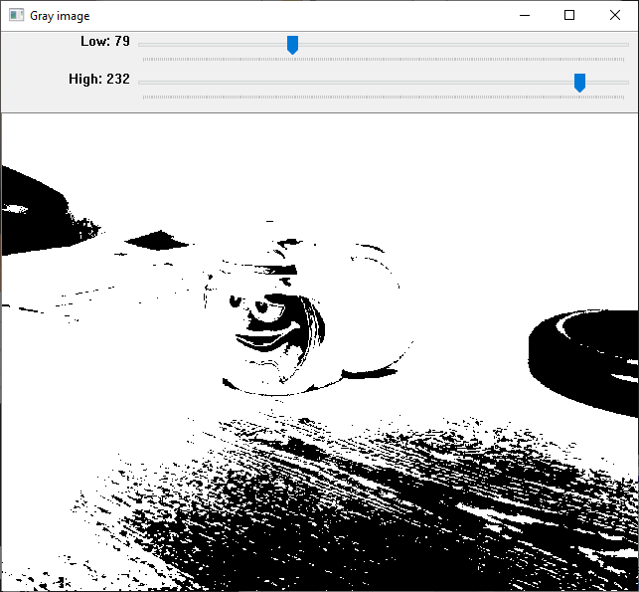
low_thresholds = [50, 50, 50] high_thresholds = [250, 250, 250] def main(): bgr_img = cv2.imread("cup.jpg") image_height = bgr_img.shape[0] image_width = bgr_img.shape[1] # Convert BGR to HSV. hsv_img = cv2.cvtColor(bgr_img, cv2.COLOR_BGR2HSV) # Split into the different bands. planes = cv2.split(hsv_img) windowNames = ["Hue image", "Saturation image", "Gray image"] for i in range(3): cv2.namedWindow(windowNames[i]) # Create trackbars. for i in range(3): cv2.createTrackbar("Low", windowNames[i], low_thresholds[i], 255, nothing) cv2.createTrackbar("High", windowNames[i], high_thresholds[i], 255, nothing) while True: # Create output thresholded image. thresh_img = np.full((image_height, image_width), 255, dtype=np.uint8) for i in range(3): low_val = cv2.getTrackbarPos("Low", windowNames[i]) high_val = cv2.getTrackbarPos("High", windowNames[i]) _,low_img = cv2.threshold(planes[i], low_val, 255, cv2.THRESH_BINARY) _,high_img = cv2.threshold(planes[i], high_val, 255, cv2.THRESH_BINARY_INV) thresh_band_img = cv2.bitwise_and(low_img, high_img) cv2.imshow(windowNames[i], thresh_band_img) # AND with output thresholded image. thresh_img = cv2.bitwise_and(thresh_img, thresh_band_img) cv2.imshow("Output thresholded image", thresh_img) if not cv2.waitKey(100) == -1: break def nothing(x): pass

Slide 18
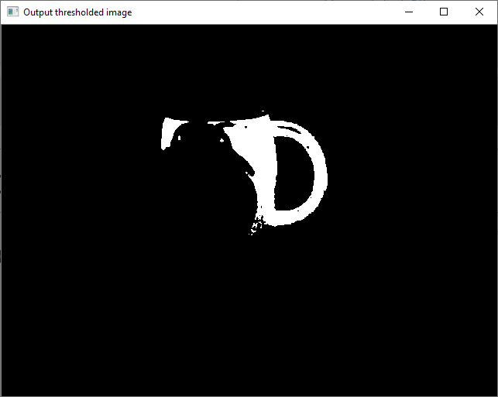
Output combined thresholded image
You could now do morphological operations, connected component labeling, etc

Slide 19
Summary
Color values can be represented using red, green, blue (RGB) values.
An alternative representation is hue, saturation, intensity (HSI), also called HSV
HSV is usually better for color image analysis
How would you smooth a color image (e.g., with a Gaussian low pass filter)?

